Slide 1
Lightning Talk 3 – User Needs and Requirements
sdmay25-16

Slide 2
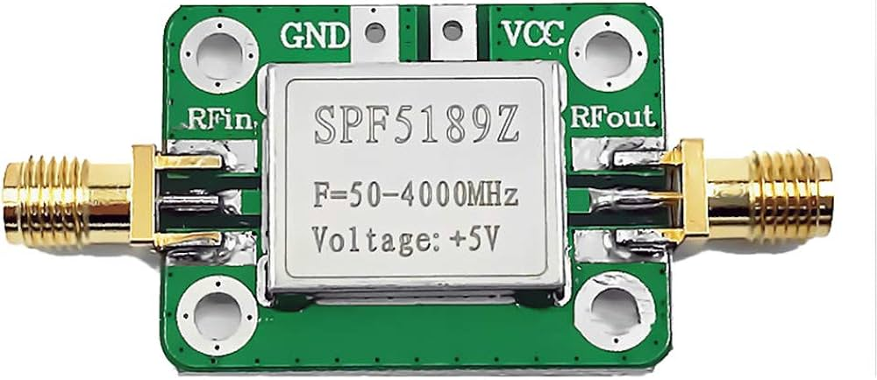
Project Overview
Problem Statement: Design and build an 8/16 channel amplifier with little noise to boost ultrasound signals received for a photoacoustic imaging system.
Constraints:
Low noise
Low input impedance
Bandpass filtering: 10kHz-1MHz
Small size (< 5x5 cm each)
ESD protection

Slide 3
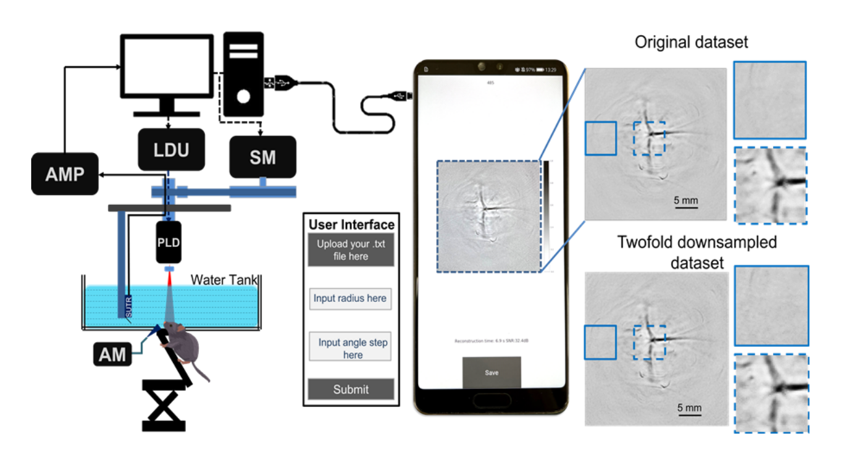
Users Needs
High resolution images
Easy to use and install
Adaptable for different uses/configs

Slide 4
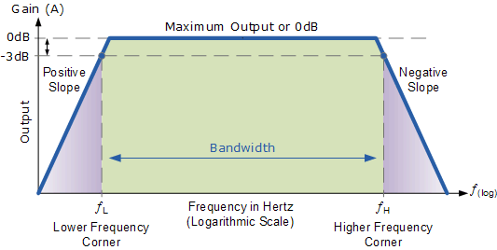
Requirements
Performance:
Low noise
High gain (>=1000 V/V)
Bandwidth: 10kHz to 10MHz
Electromagnetic shielding/EMC comapatiblity
Ease of Use
Needs to provide 5V power from wall outlet
Ability to mount on PAT machine
Adaptability
Ability to use 8 or 16 channels (modularity)
Possibly add controls for each individual amplifier

Slide 5
Engineering Standards
IEEE 1597.1-2022 – IEEE Standard for Validation of Computational Electromagnetics Computer Modeling and Simulations
IEEE C63.2-2023 - American National Standard for Specifications of Electromagnetic Interference and Field Strength Measuring Instrumentation in the Frequency Range 9 kHz to 40 GHz
IEEE/AIEE 33-1927 - AIEE Standards - Electrical Measuring Instruments
IEEE 790-1989 - IEEE Guide for Medical Ultrasound Field Parameter Measurements

Slide 6
Conclusions
Thinking about the application and what needs to be done differently for it to work for the photoacoustic sensor
Functionality most important aspect
Usability and simplicity second most important
Limited users means very clear needs

